Slide 1
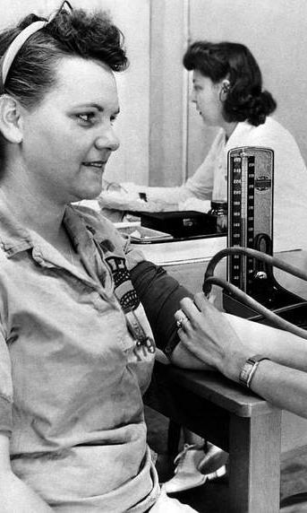
NURS 608 Comparing nursing theories:
Imogene king’s theory of goal attainment and Janice bell’s illness beliefs model
By Jala Hassanien

Slide 2
Why these theories
Both theories emphasize therapeutic relationships and person-centred care.
Both recognize patients as active participants in their care.
These theories align with my practice as a new graduate nurse on a cardiac step-down unit, where communication and understanding patient priorities are essential.

Slide 3
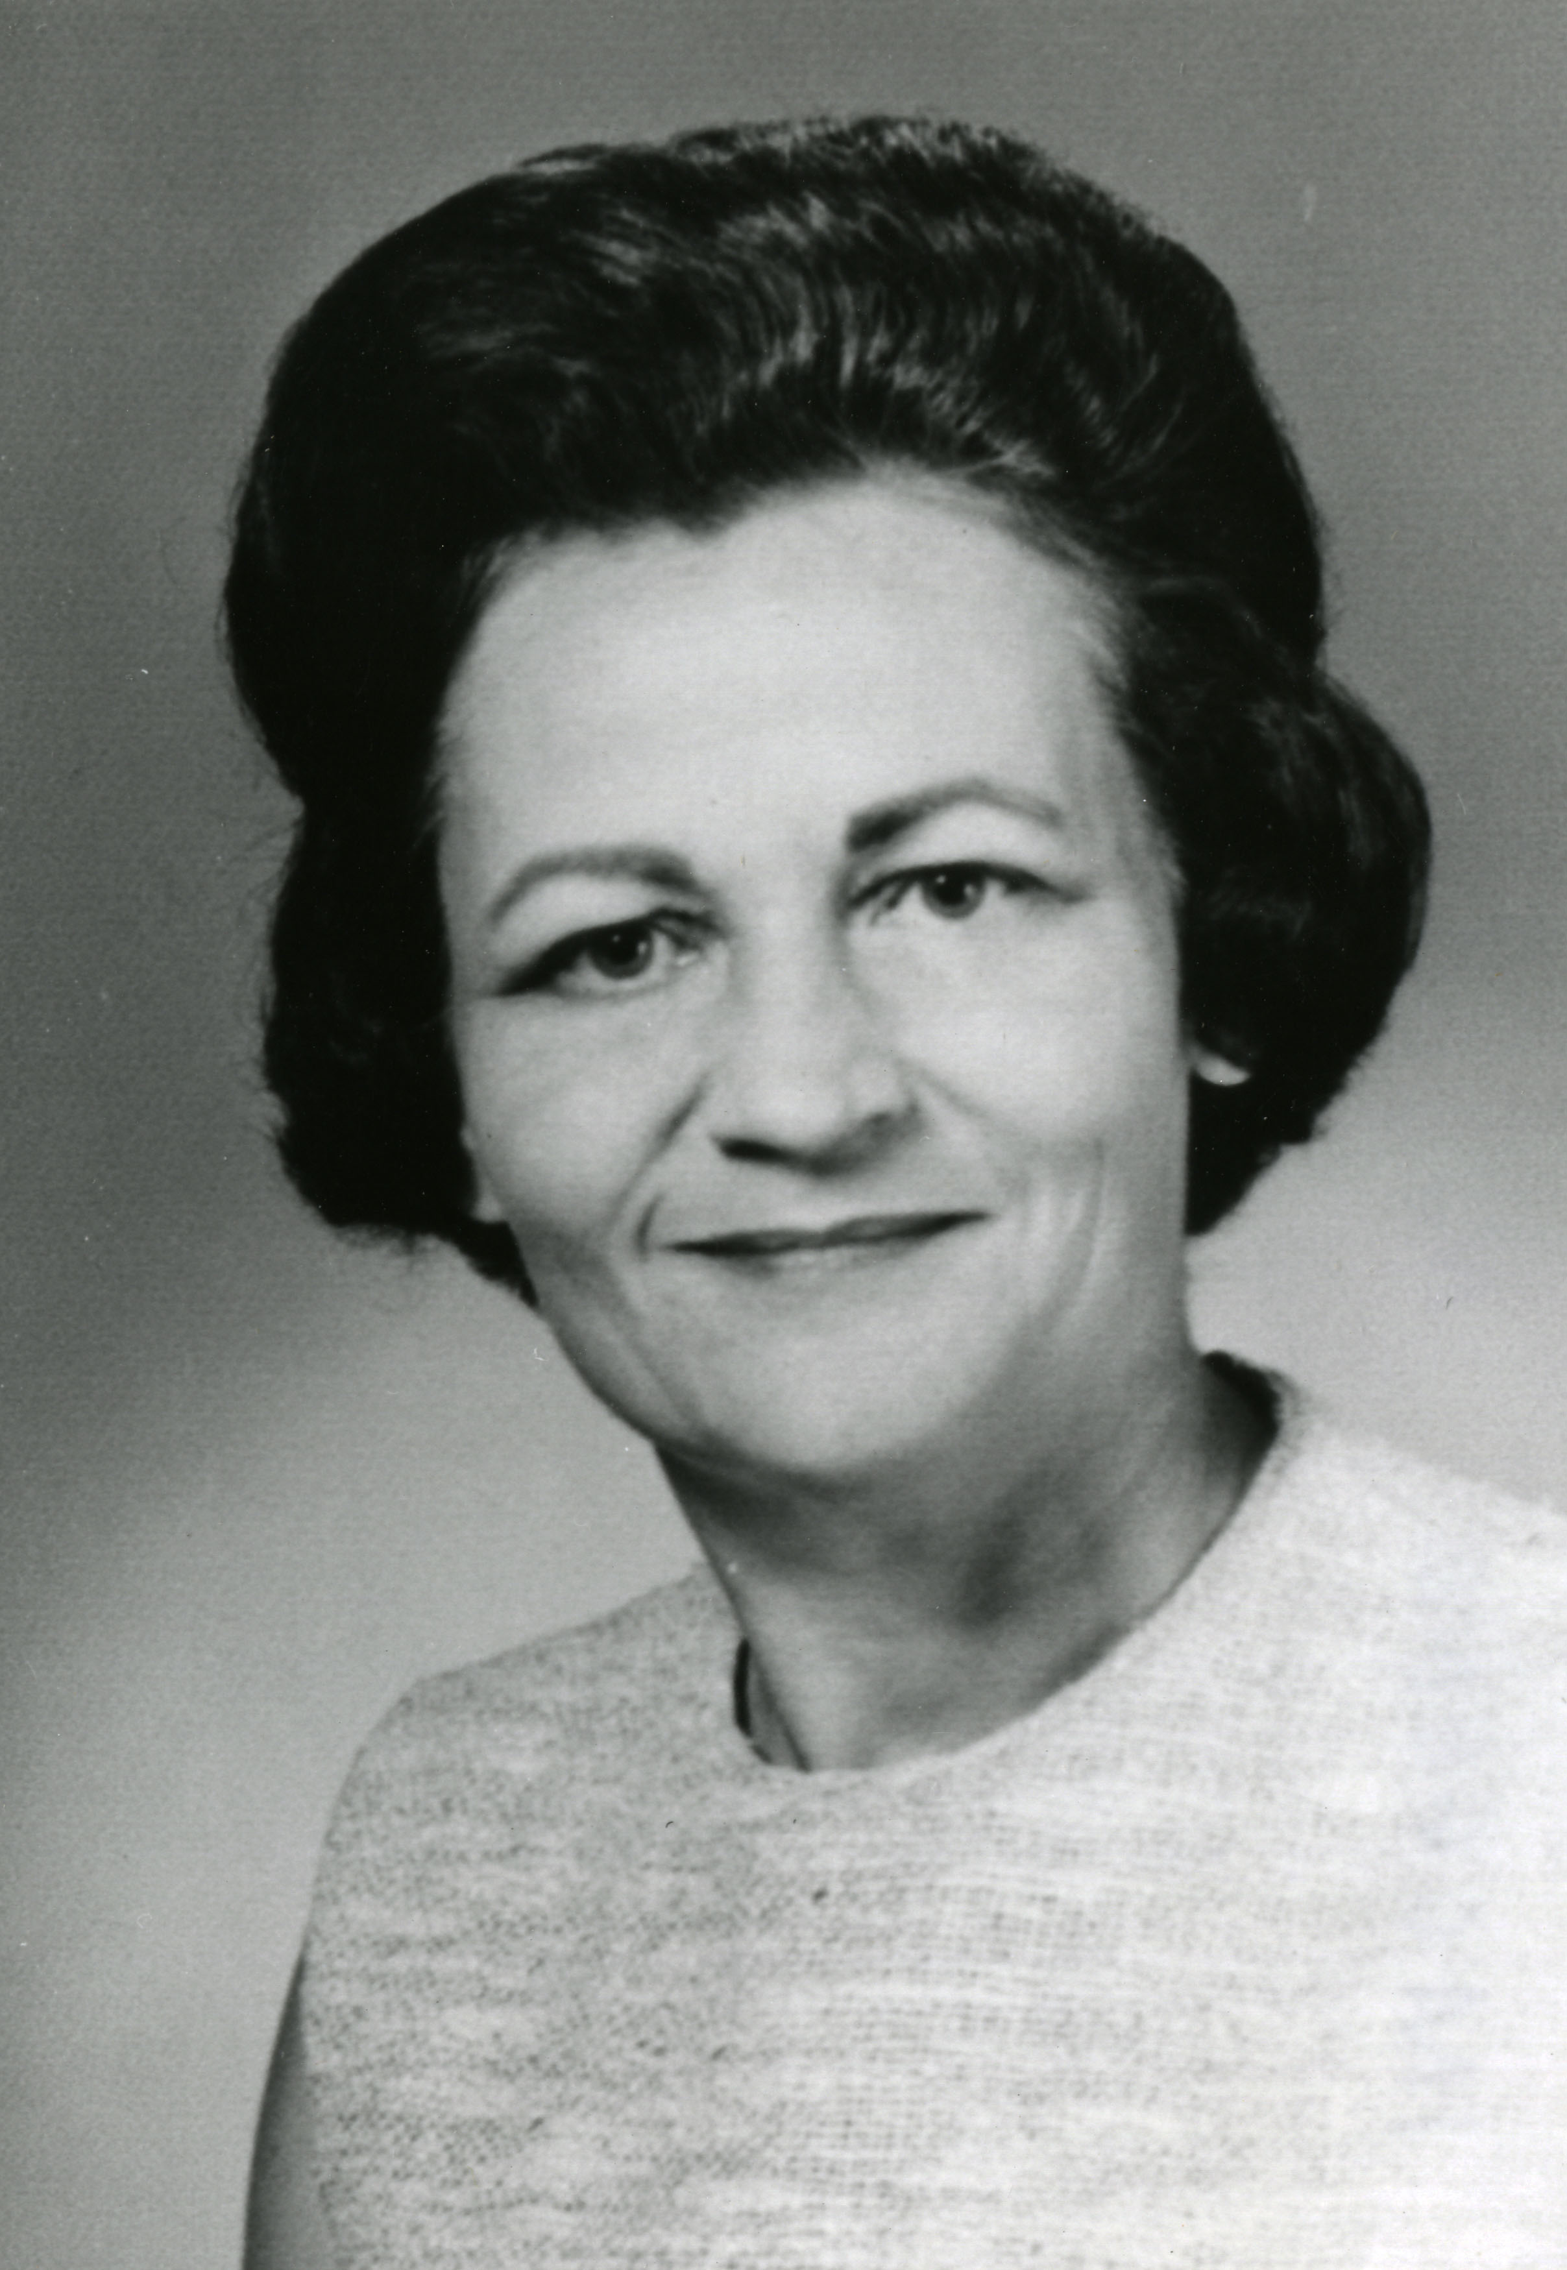
Imogene king: classic theorist
Background
Imogene King (1923–2007)
Nursing theorist and educator
Developed the Theory of Goal Attainment in the 1960s and 1970s
Considered a classic grand nursing theorist
Purpose of Theory
To help nurses and patients work together to identify and achieve mutually agreed-upon health goals.

Slide 4
theory of goal attainment
Central Assumption: When nurses and patients communicate effectively and establish mutually agreed-upon goals, health outcomes are improved.
King proposed that nursing is a process of interaction between the nurse and patient. Through communication, both individuals share information, identify concerns, establish mutual goals, and work together to achieve those goals.
Key Components
Personal System: Individual perceptions, values, growth, and experiences that influence health decisions.
Interpersonal System: Nurse-patient interactions involving communication, roles, stress, and transactions.
Social System: Larger systems that influence care, such as family, healthcare organizations, and society.

Slide 5
Applying king’s theory
Nursing Actions
Explore patient's goals.
Identify priorities important to the patient.
Collaboratively develop achievable goals.
Example Goals
Manage symptoms.
Improve activity tolerance.
Safely discharge home.
Maintain independence.
Focus: Mutual goal setting and collaboration.

Slide 6
Advantages and limitations of king’s theory
Limitations
✖ Assumes patients can communicate and participate.
✖ Less emphasis on family beliefs and context.
Advantages
✔ Encourages shared decision-making
✔ Provides clear direction for practice
✔ Easily applied in acute care settings

Slide 7

Janice bell: contemporary theorist
Background
Canadian nurse theorist and family nursing scholar
Developed the Illness Beliefs Model
Grounded in family systems nursing Focuses on beliefs held by patients, families, and healthcare professionals
Purpose of Theory
To understand how beliefs shape illness experiences, suffering, coping, and healing.

Slide 8
Illness belief model
Central Assumption: Beliefs shape illness experiences and can either constrain or facilitate healing.
Bell's model suggests that the beliefs held by patients, families, and healthcare providers influence how illness is experienced, managed, and understood. Often, suffering is shaped not only by the illness itself, but by the meaning attached to it.
Core Concepts
Constraining Beliefs: Beliefs that increase suffering or limit possibilities
Facilitating Beliefs: Beliefs that promote coping, resilience, and healing.
Nurse’s Role: Help patients and families examine beliefs that may either constrain or facilitate healing.

Slide 9
Advantages and limitations of Bell’s Model
Limitations
✖ Requires time and advanced communication skills
✖ May be difficult to apply consistently in busy clinical setting
Advantages
✔ Supports family-centered care
✔Addresses emotional and psychosocial aspects of illness
✔ Helps identify sources of suffering

Slide 10
Applying bell’s model
Nursing Actions
Explore beliefs about illness.
Identify constraining beliefs.
“There is no point trying because heart disease runs in my family.”
Facilitate discussion around these beliefs.
Potential reframe: “While family history is important, there are still things you can do to improve your quality of life.”
Focus: Understanding the meaning the patient gives to illness.

Slide 11
Similarities between models
Recognize patients as active participants.
1
Require strong nurse-patient relationships.
2
Support individualized care.
3
Promote holistic nursing practice.
4

Slide 12
Differences between models
King’s Theory | Bell’s Model
Focuses on achieving goals | Focuses on understanding beliefs
Emphasizes transactions and mutual goal setting | Emphasizes meaning and illness experiences
Primarily individual-focused | Strong family systems perspective
More structured and action-oriented | More reflective and exploratory

Slide 13
Application to my practice
As a new graduate nurse on a cardiac step-down unit, both theories inform my practice.
King's theory guides collaborative goal setting with patients related to discharge planning, mobility, and self-management.
Bell's Illness Beliefs Model helps me understand how patients and families interpret illness and why some individuals respond differently to similar diagnoses.
Together, these theories remind me that effective nursing involves both working toward clinical goals and understanding what health, illness, and recovery mean to each patient.

Slide 14
References
Bell, J. M., & Wright, L. M. (2015). The Illness Beliefs model. Journal of Family Nursing, 21(2), 179–185. https://doi.org/10.1177/1074840715586889
Bsn, A. G., RN. (2024, October 23). Imogene King: Theory of Goal Attainment. Nurseslabs. https://nurseslabs.com/imogene-m-kings-theory-goal-attainment/
International Family Nursing Association. (2015, January 30). Illness Beliefs Model | International Family Nursing Association. https://internationalfamilynursing.org/file-link/illness-beliefs-model/
Real, A. (n.d.). Who is Imogene King? Nursing theory explainer. Credenza. https://credenzahealth.com/career-advice/who-is-imogene-king-nursing-theory-explainer

